Slide 1
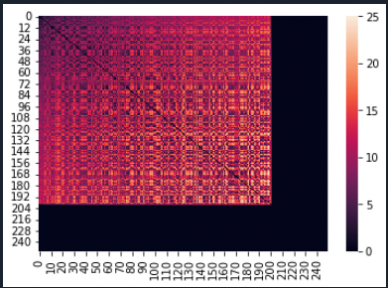
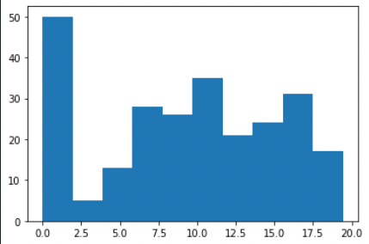
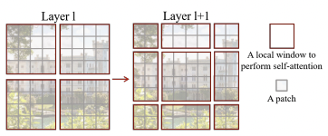
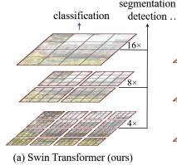
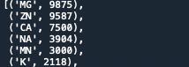
Plans
1. A simple model to compare with Unet
Train a simple model using Zn²⁺ (large data, one atom)
Several axial self-attention layers
Heatmap and distribution for visualization
2. Swin transformer
Hierarchical feature maps
Shifted window allows cross-window connection
3. Imbalanced data
Loss function

Slide 2
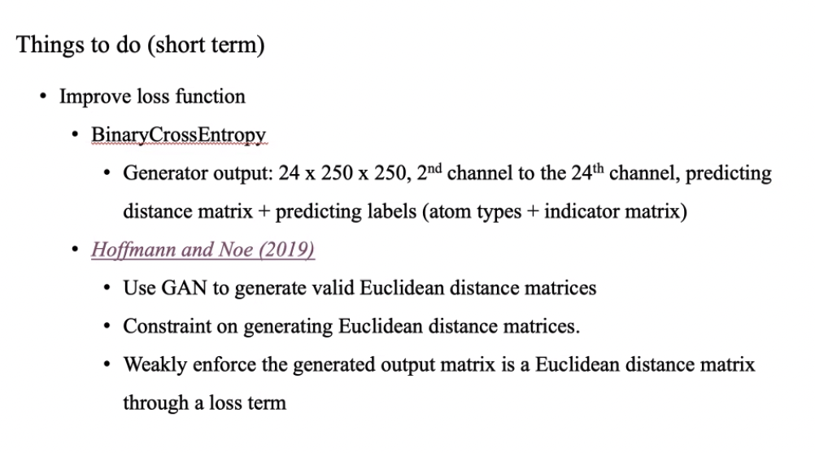

Slide 3
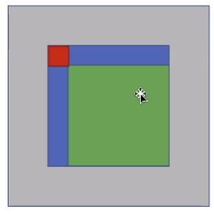
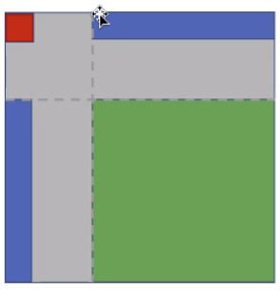
Input

Slide 4
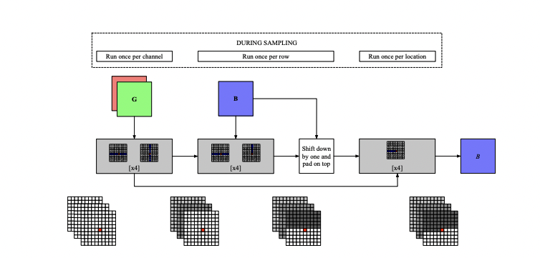
Simple network structure

Slide 5
0617 Task done
Data
Split ligands into groups by their charge
Padding
Model
Training + Test
Charge | # kind | # sample
Positive | 27 | 38,826
Negative | 1 | 7
Neutral | 116 | 17,863
 | 144 | 56,696 + 14,174

Slide 6
0617 Comparison
Dataset | Starting position | Model | Test performance (mean/median/std) | Running time /epoch
Zn-ligand (9k+) | + | Simple (0.004 M) | 1.9/1.1/1.8 | ~3min
Cu-ligand (100+, aug 50k) | + | Pix2pix (#G:268M + #D) | 1.2/1/0.97 | ~8+min (Cu-ligand)
Ligands with positive and neutral charge
Dataset | Starting position | Dataset size | Test performance
Positive | + | 38.8k/9.7k | 0.67/0.43/0.77 (10 epochs)
Neutral | + | 17.8k/4.4k | 5.45/5.41/1.39 (10 epochs)

Slide 7
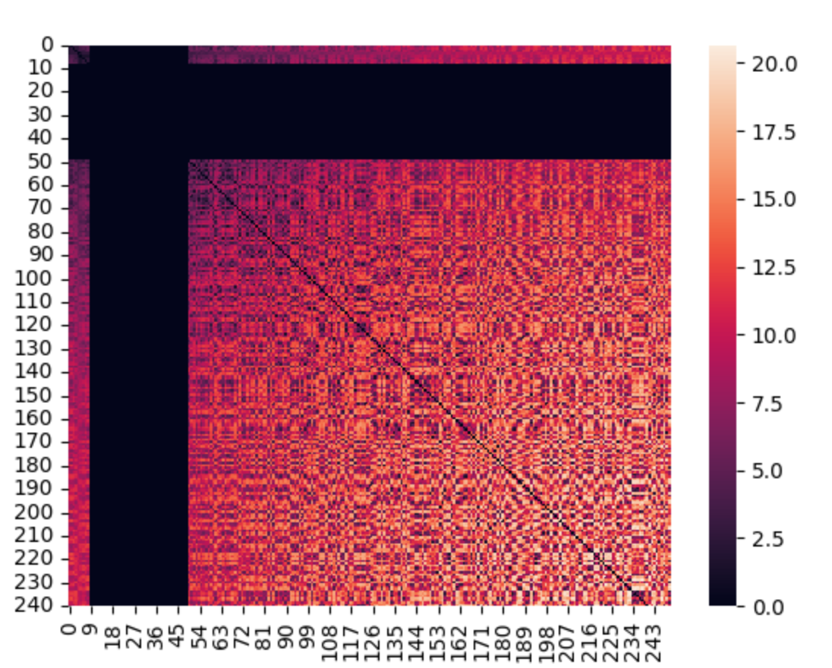
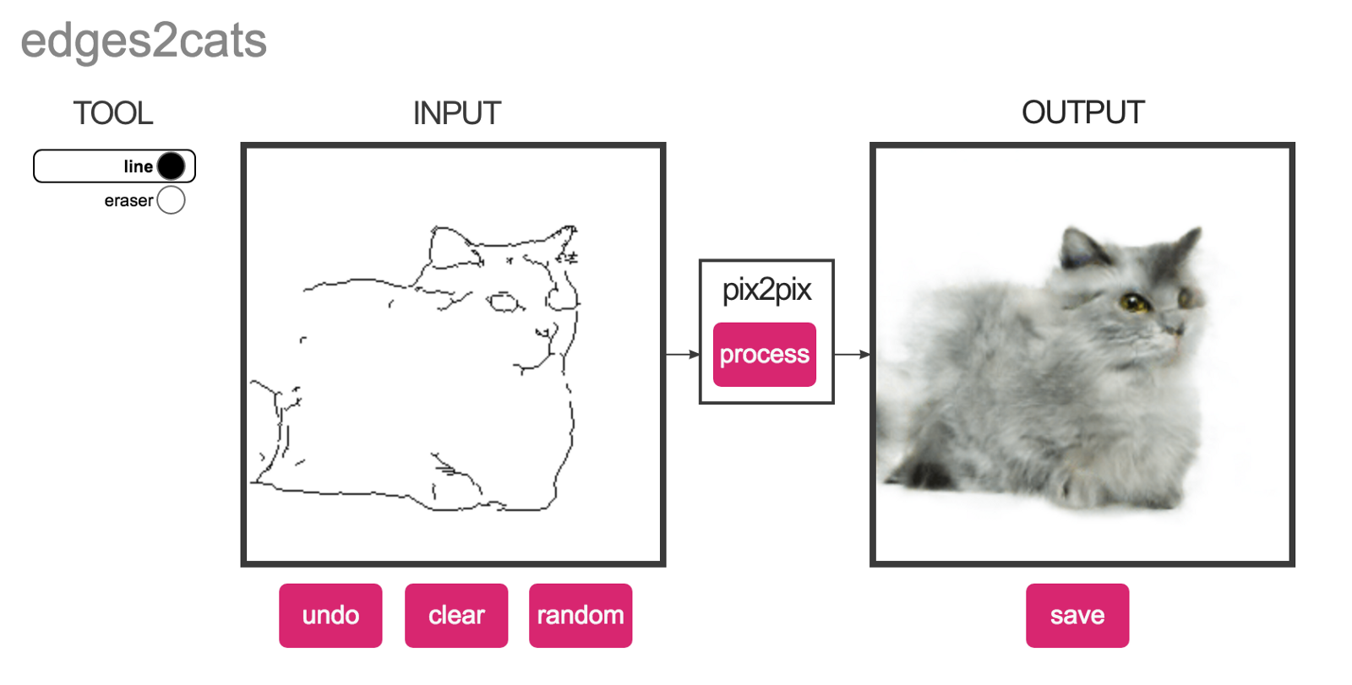
0617 Prob and To-do
Main issue: training time
Data
If exploring potential initial positions is needed?
Model
Analyze memory usage
Choose a suitable batch size?
OSError No space left on device
To-do
Generate and save
Fix model training issues
Fill out blanks in tables
Explore more model architectures

Slide 8
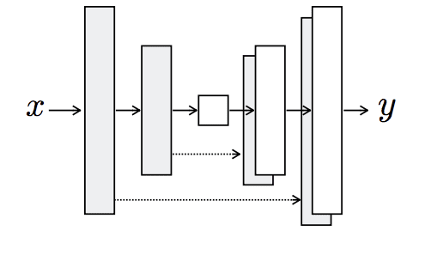
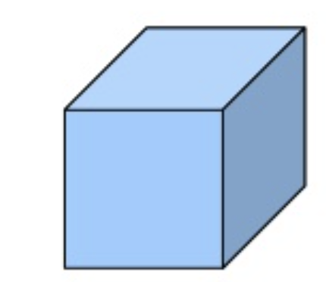
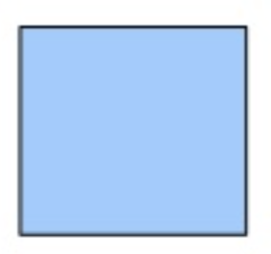
0630 Model
Unet + self-attention layers
Conv layer
Kernel size 1x1
L1 loss
[250, 250, 23]
Gray area = 0
[250, 250, 23]
True pairwise distance mx

Slide 9
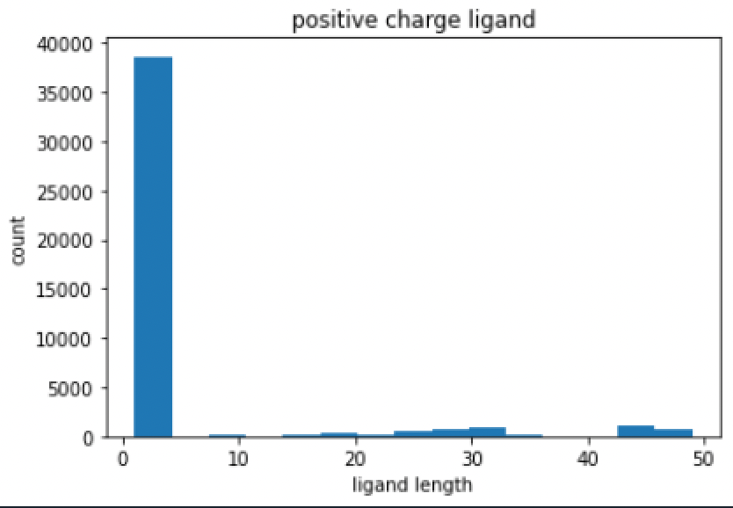
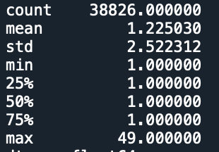
0630 Statistics
Positive charge
training

Slide 10
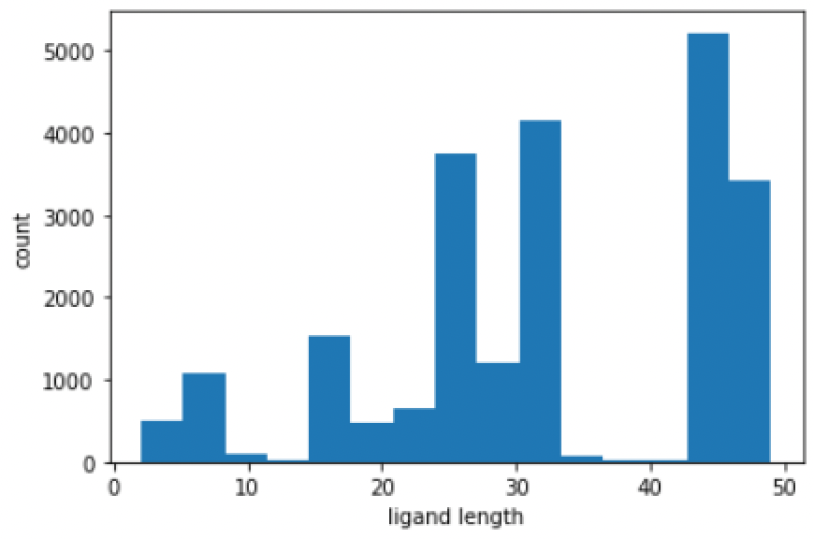
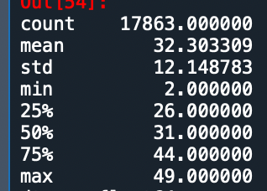
0630 Statistics
Neutral charge
training

Slide 11
0630 Comparison
Ligands with positive and neutral charge
Dataset | Model | Dataset size | Test performance （mean/median/std）
Positive | G + Conv2D | 38.8k/9.7k | 0.67/0.43/0.77 (10 epochs)
Neutral | G + Conv2D | 17.8k/4.4k | 5.45/5.41/1.39 (10 epochs)
Prev. result 05/10
=0.67*9.7+5.45*4.4/(9.7+4.4) =2.16
Dataset | Model | Dataset size | Test performance
Positive + Negative + Neutral | G + D | 56.7k/14.1k | 3.27/2.36/2.39

Slide 12
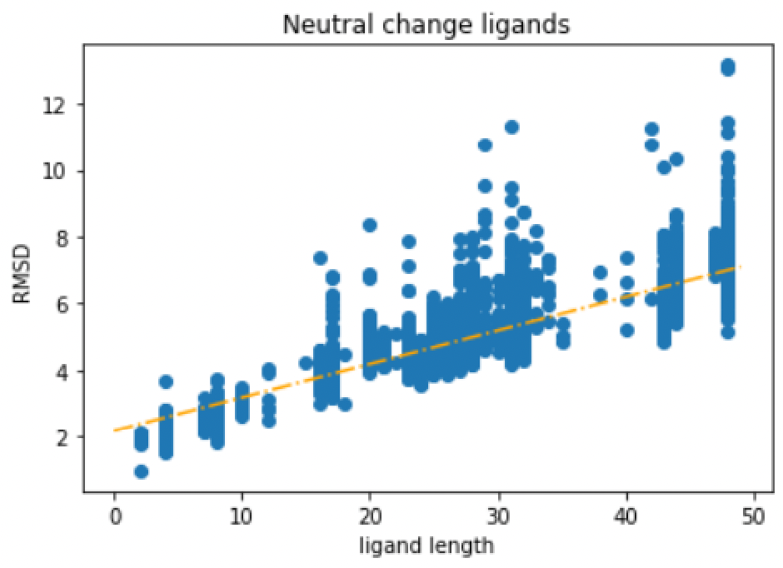
0630 Analysis
Regress RMSD on ligand length
- coefficient = 0.1

Slide 13
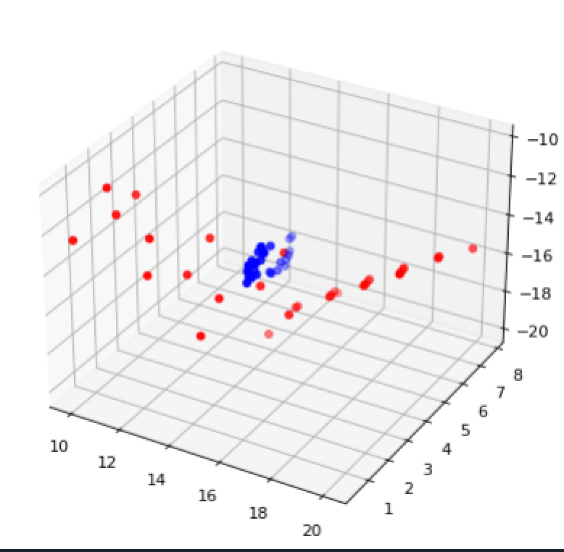
0630 To-do
Neutral charge
Draw plots for outliers (before vs. after)
Ligands are located on channel 23; Inserting them into other channels according to atom type might adopt more info
Shape
Metal atom positions paper
Metal type
Given metal type, location

Slide 14
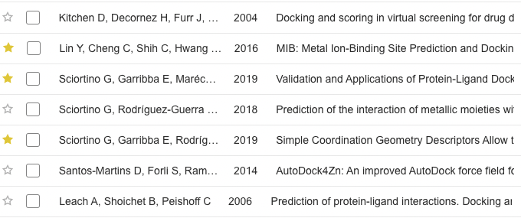
0704 Papers
GaudiMM: See if metal types are known
GaudiMM: If whole protein is given
MetalPDB: Construct similar dataset
Current two years, citations (2019
Focus on metal (positive)
Key word: protein-ligand docking for metal ligand
Other focuses: geometry of coordination, ligand conformation

Slide 15
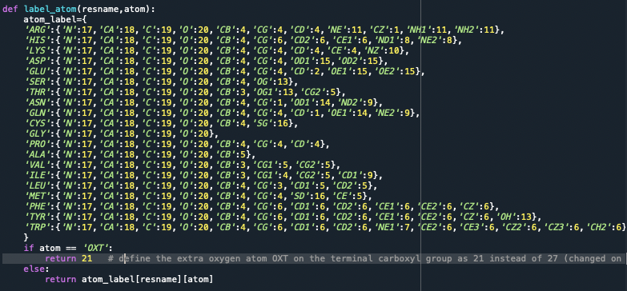
0704 Ligand embedding
Now: Don’s distinguish ligands’ atom types, put all in channel 23
After: there is no channel 23, ligands are scattered from 2nd to Xth channel
Need to encode ligands’ type into existing dictionary
Simplest case would be Zn and etc..

Slide 16
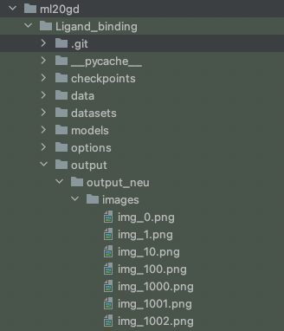
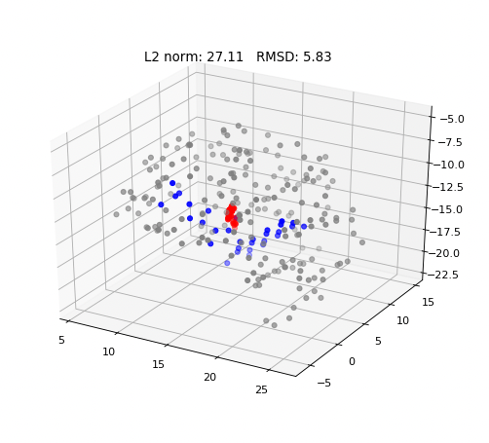
0704 More plots (neutral charge ligands)

Slide 17
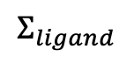
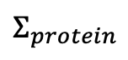
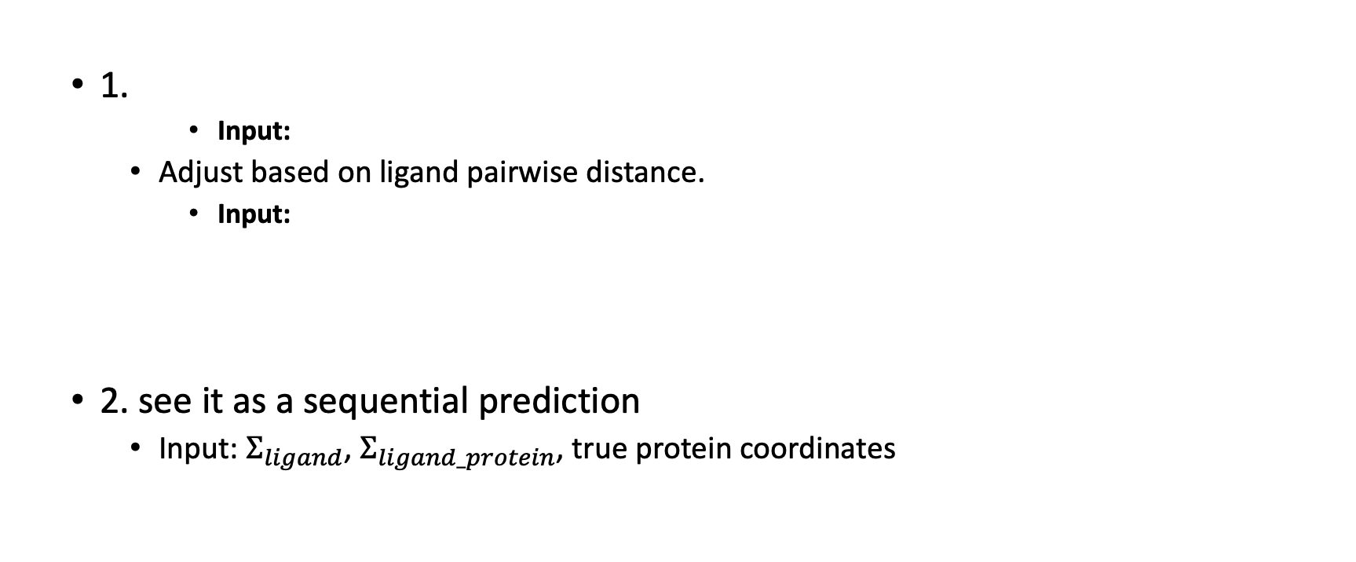

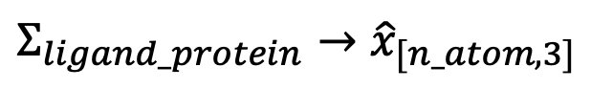
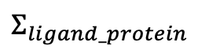
0704 Coordinates recovery
1.
Input:
Adjust based on ligand pairwise distance.
Input:
2. see it as a sequential prediction
Input: $Σ_{ligand}$, $Σ_{ligand_protein}$, true protein coordinates
$${Σ_{ligand_protein}→\hat{x}}_{[n_atom, 3]}$$
Protein coordinates
$$min⁡{\left|\left(x−\hat{x}\right){\left(x−\hat{x}\right)}^{T} \right|}_{F}$$
$\operatorname{st}{cov\left(x\right)}=Σ_{ligand}$
$$Σ_{ligand}$$
$$Σ_{ligand_protein}$$
Protein coordinates
$$Σ_{protein}$$

Slide 18
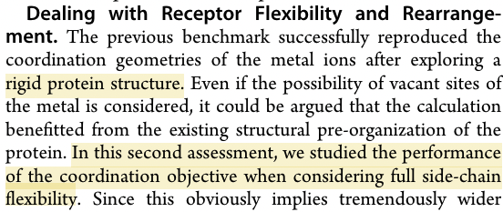
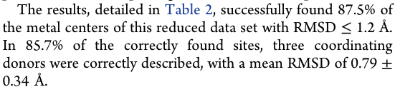
0715 Papers
See if metal types are known
If whole protein is given
Rigid protein structure
Current two years, citations (2019
Construct similar dataset
- Performance

Slide 19
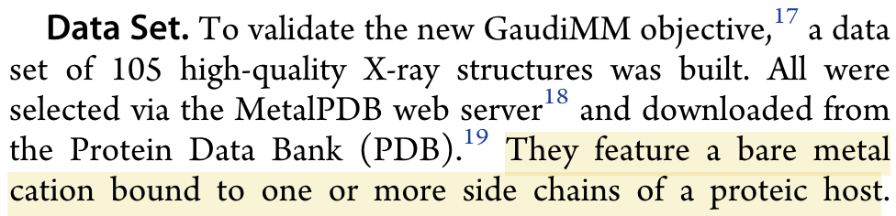
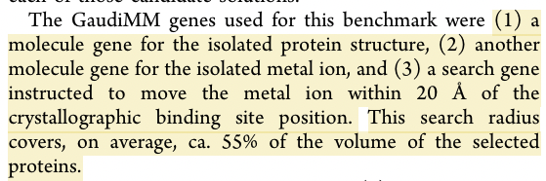
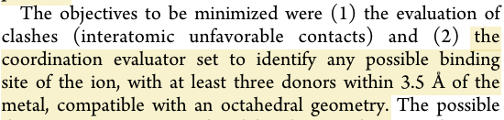
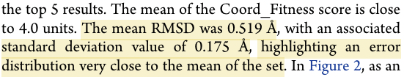
0715 Papers
- Dataset
- Benchmark input
- Coordination evaluator
- Model Performance
GaudiMM: A modular multi‐objective platform for molecular modeling

Slide 20
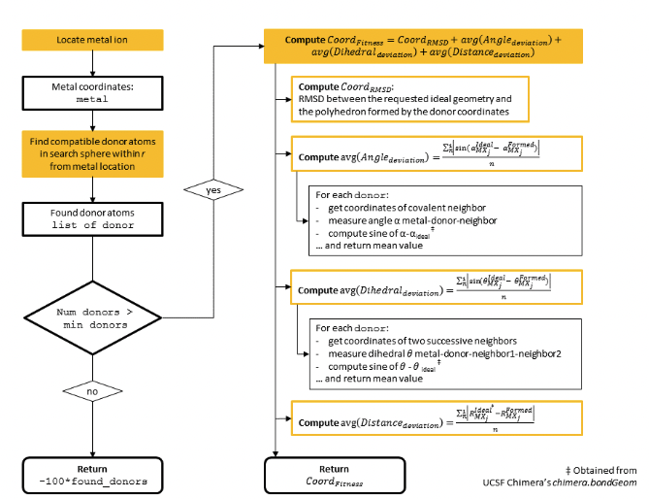
0715 Papers
Coordination objective flowchart
Locate metal ion
Found donor atoms
Compute Coord_Fitness
Pose: Coord_RMSD
Directionality: the rest

Slide 21
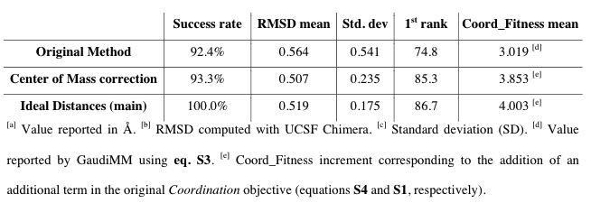
0715 Papers
UCSF Chimera

Slide 22
0722 Conformation RMSD
Vanilla methods
Locate metal ion (our model output)
Found all atoms in search sphere within r = 5 A from predicted and real metal location -> two sets of same size: pt1, pt2
Pose: Coord_RMSD
Perform CPD on pt1 -> pt1_tilda (pkg: pycpd)
Compute RMSD bw pt1_tilda and pt2
1. Found donor atoms ?? Done.
2. M = min(|pt1|,|pt2|)
L2 norm to metal
Keep the M closest points for each set

Slide 23
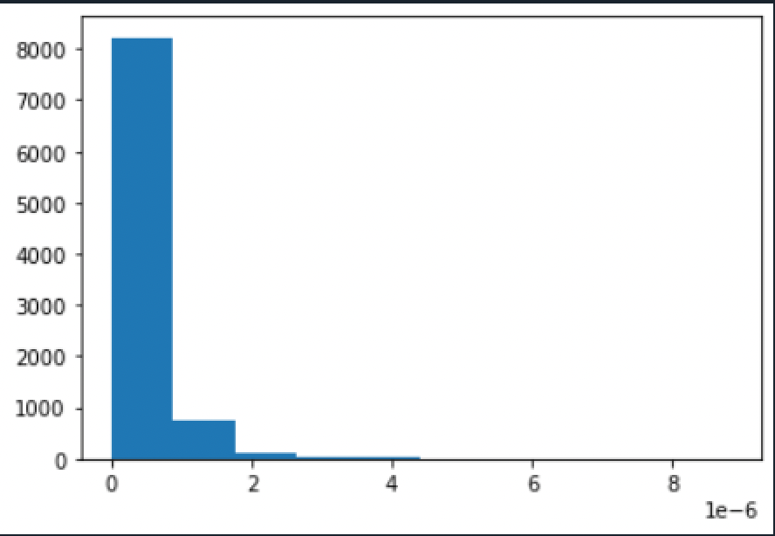
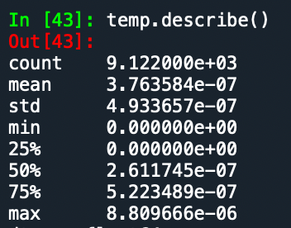
0722 Result and Plot
RMSD:

Slide 24
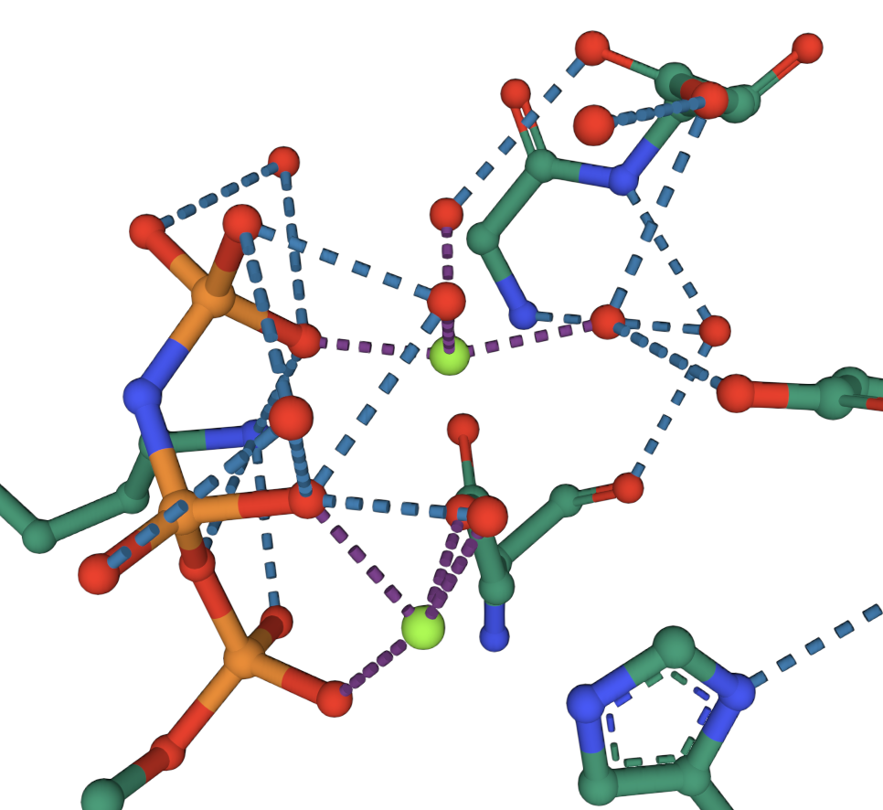
0722 Potential Issues
1. Vanilla method ignores some details
2. More samples than shown on PDB website
PDB: 5i1d
3D view shows 3 MG
But our training has 7 samples and test 1 sample

Slide 25
0722 Next step
Literature Review: ML and Protein-ligand docking (pose)
Starting from GaudiMM or searching python pkg for RMSD?
https://drugsniffer.org/

Slide 26
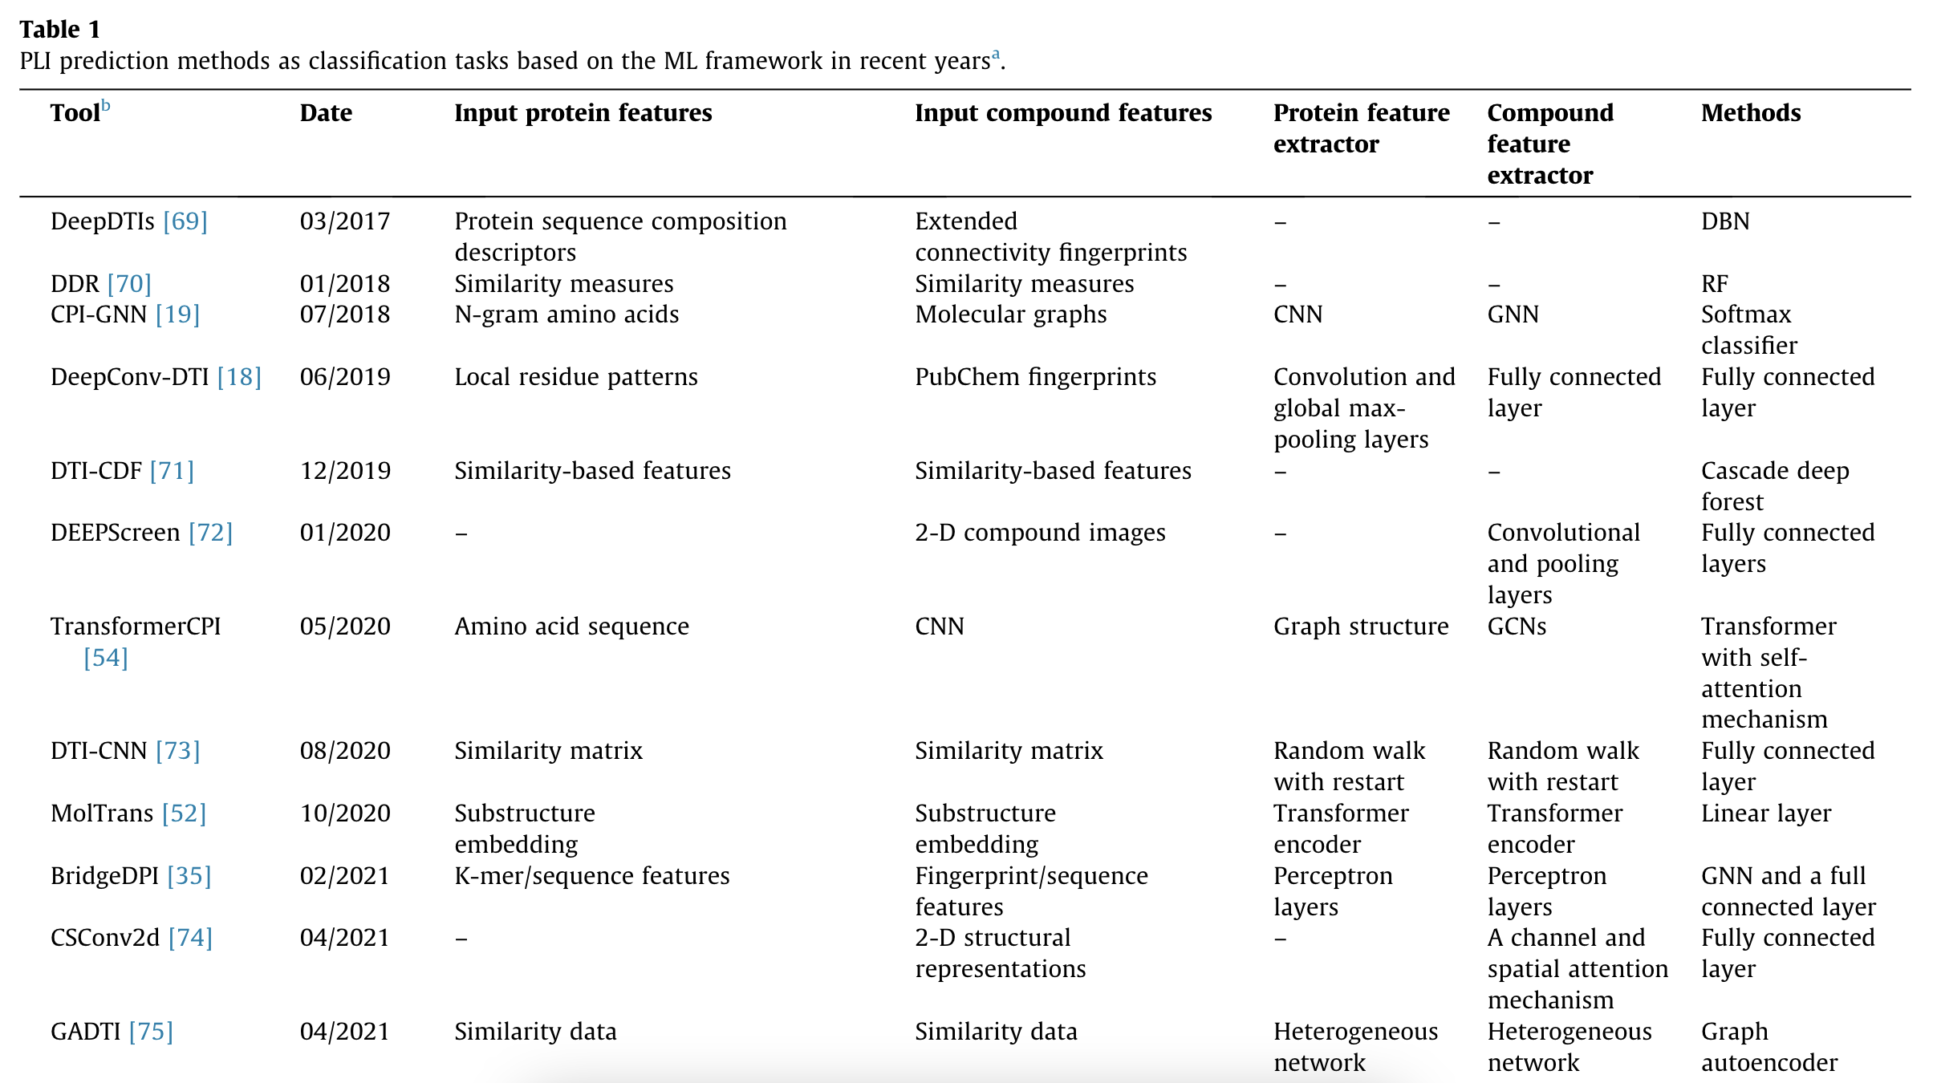
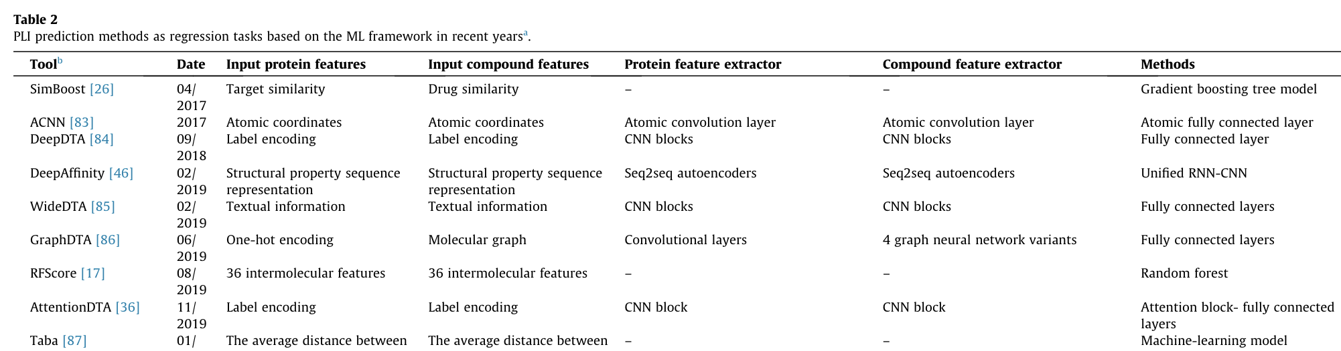
0729 ML literature reviews
Detecting binding residues
Binding affinities

Slide 27
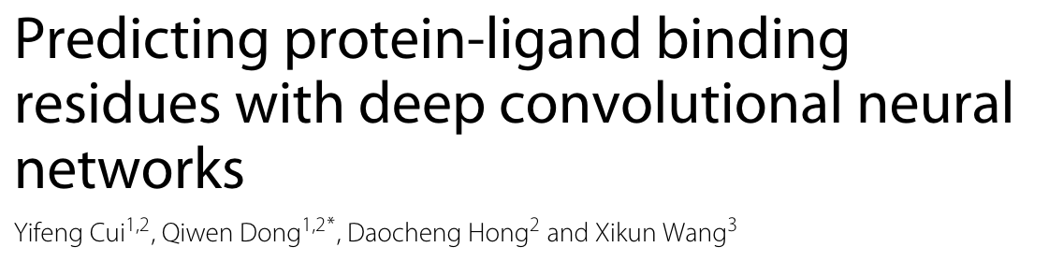
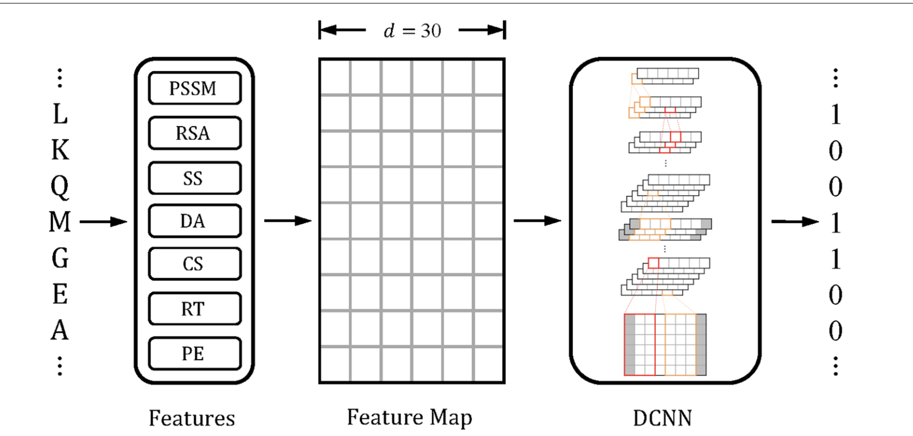
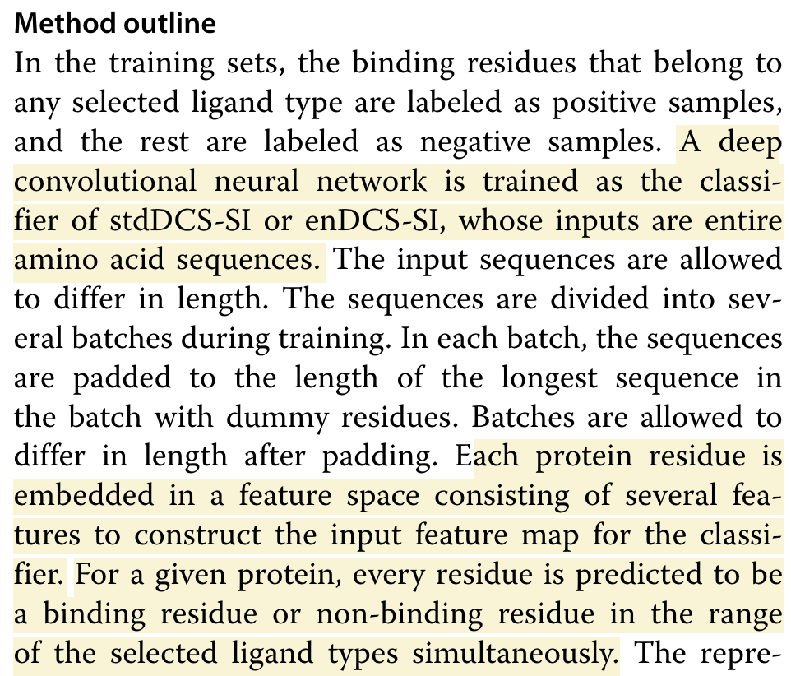
0729 Classification (example)

Slide 28
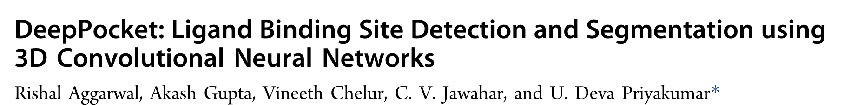
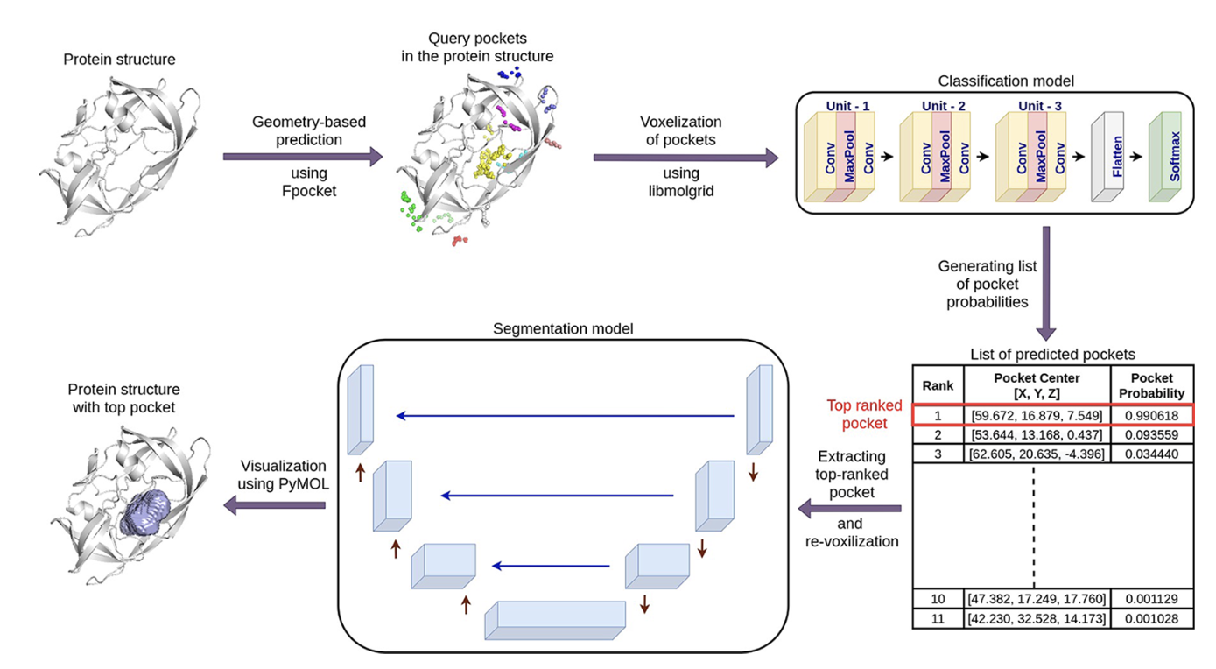
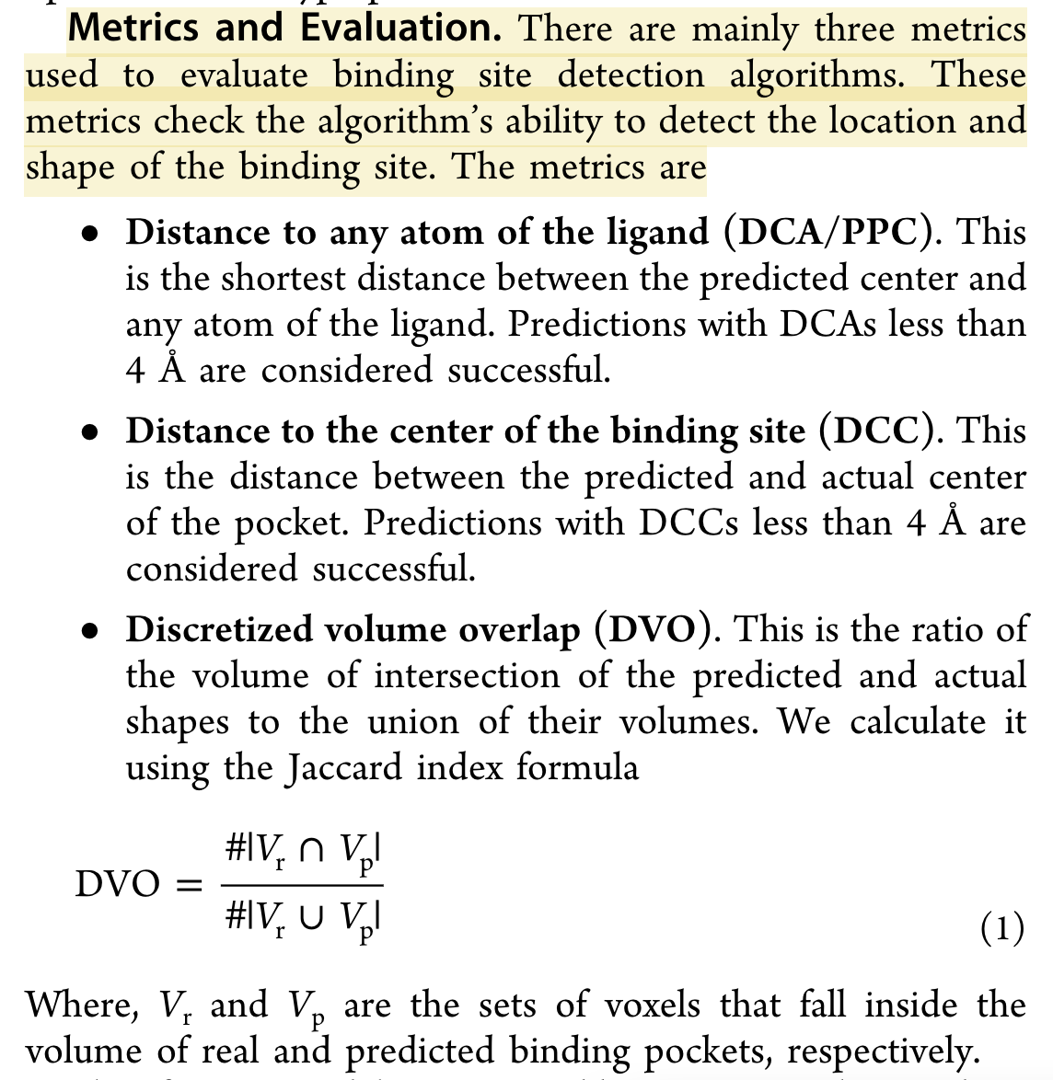
0729 DeepPocket: metrics

Slide 29
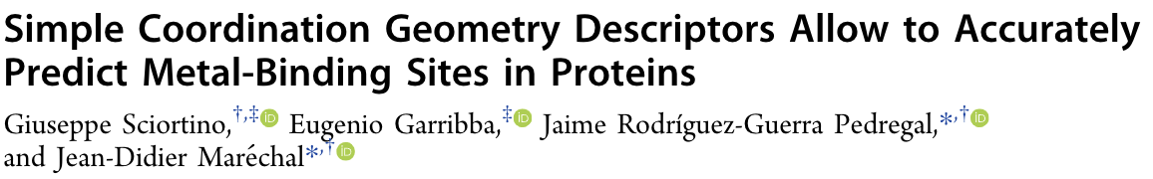
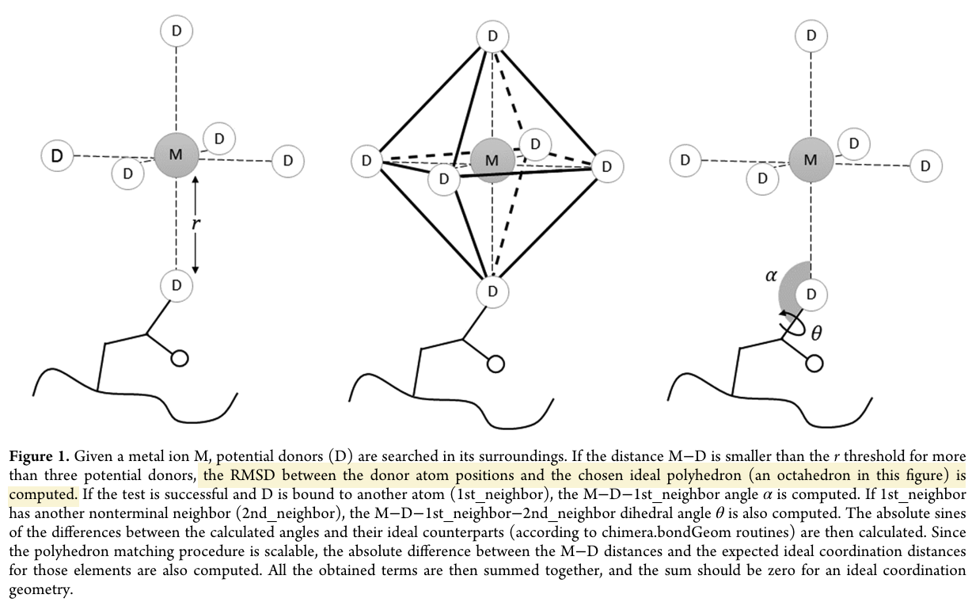
0729 Simple Coordination Geometry

Slide 30


0729 DL Algo
Notes:
https://lucid.app/lucidchart/b615ccbc-f1cf-4587-9723-f247311884ee/edit?beaconFlowId=634EC14664C51507&invitationId=inv_47f66e8e-a1dd-4f9c-a5d0-cce10f9234bc&page=0_0#

Slide 31

0729 Results (draft)
RADIUS = 5.5/4.5
Min donor atoms = 3
1. Tuning radius
2. DCC or coord_fitness: apply to RL
R = 4.5 6.3k/9.7k
Coord_RMSD:
Mean = 0.315, median = 0, std = 1.029
Coord_fitness:
Mean = 1.084, median = 0.239, std = 6.44

Slide 32
0812 RL results
DCC- Cu: distance bw predicted and actual center of the pocket
<= 4 as success [85.2%]
An average DCC success rate 81%
Conformation RMSD - Cu: [0.519/./0.175]
R = 2.5
RMSD: mean/median/std: 1.87/1.53/1.69 (3,663/4,000)
Atoms: mean/median/std: 2.24/2/1.11
R = 3.5
RMSD: mean/median/std: 2.65/2.78/1.27 (3,891/4,000)
Atoms: mean/median/std: 7.03/7/3.15

Slide 33
0819 What we have done
1. A simpler model – Unet + attention layers
2. A generalized dataset – all metal ions benchmarked in AlphaFill
3. Two metrics for model performance
DCC ~ Distance RMSD (our: 98.6% vs 85.2%; <= 4.0)
Conformation RMSD (our: 0.315* vs 0.519) + Directionality (mean = 1.083; <= 5.0)
4. Wrap up RL

Slide 34

0819 What we will do
More Ideas on
Dataset
Metrics (12 types of metal ions in MIB)
Network architectures (DeepPocket - Unet, ablation study for attention layer)
Start to write something?
Draw local
Fair comparison metrics
Network architecture

Slide 35

MIB is a binding site prediction web server for mental ions. Predictions of residues that bind 12 types of metal ions are supported.
The query protein structure is compared with each metal-binding template to locate the metal-binding residues
Each residue of the query protein is assigned a binding score. If the value is higher than a specified threshold, this residue is predicted to be a metal-binding residue.
Supported mental ions: Ca2+, Cu2+, Fe3+, Mg2+, Mn2+, Zn2+, Cd2+, Fe2+, Ni2+, Hg2+, Co2+, or Cu+ ion

Slide 36



0909 More metal ions

Slide 37
0909 More metal ions
 | MOAD | Training | Test
Mg2+ | 12453 | 8661 | 2724
Zn2+ | 12032 | 8275 | 2239
Ca2+ | 9366 | 6579 | 2124
Na+ | 4966 | 3276 | 1296
Mn2+ | 3754 | 2555 | 465
K+ | 2640 | 1986 | 443
Fe2+ | 547 | 341 | 167
Ni2+ | 743 | 537 | 55
Co2+ | 576 | 399 | 124
Fe3+ | 1024 | 721 | 176
Cu2+ | 278 | 207 | 25
Ba2+ | 74 | 66 | 7
Cu+ | 19 | 8 | 2
Cd2+ | 6 | 5 | 0
Hg2+ | 0 | 0 | 0
Au+ | 0 | 0 | 0
Pb2+ | 0 | 0 | 0
Pt2+ | 0 | 0 | 0
Sm3+ | 0 | 0 | 0
Sr2+ | 0 | 0 | 0
Total | 48478 | 33616 | 9847
Positive | 38,826
Metal ions | 48,478

Slide 38
0909 Makefile
Download MOAD every.csv,
Delete first two rows and save as every.csv
0_metal.py -> saved_ligands_new.txt, ligand_dict_new.json
Create PDB list: data_pdb/ list_file.txt
Create data_pdb: shell for downloading PDB files
summary_base.py
summary.py
Tcoffee for separating training and test

Slide 39
0930 t_coffee
Fill out the upper triangle part of a matrix of size ~(4*10^4)^2 ~ 10^9
Requires two for loops
Doesn’t not support parallel computing
Have tried several ways to accelerate:
A bug occurred in previous version
Reducing searching dataset
Efficient code to do I/O
Generate 2% per day, 50 days
400s for 10^5 elements
400*(10^9/10^5)/(60*60*24) ~ 50 days
(4*10 ⁴)²

Slide 40
0930 Alternatives
How much would this preprocessing influence our result
Alternative ways:
1. Ideally, break for loops and make it parallelable.
2. Any researchers have done this before?
3. Resample and use part of the matrix? (ex: ¼ , 10^8, 1wk)
4. Do multisequence alignment to get a rough result
5. Random sampling
Python: multisequence alignment (bio, python in parallel)
Put in 20 files, and do that
(4*10 ⁴)²

Slide 41
1
2
+
3
4

Slide 42
1019 More metal ions
 | MOAD | Training | Test
Mg2+ | 12453 | 8661 | 2724
Zn2+ | 12032 | 8275 | 2239
Ca2+ | 9366 | 6579 | 2124
Na+ | 4966 | 3276 | 1296
Mn2+ | 3754 | 2555 | 465
K+ | 2640 | 1986 | 443
Fe2+ | 547 | 341 | 167
Ni2+ | 743 | 537 | 55
Co2+ | 576 | 399 | 124
Fe3+ | 1024 | 721 | 176
Cu2+ | 278 | 207 | 25
Ba2+ | 74 | 66 | 7
Cu+ | 19 | 8 | 2
Cd2+ | 6 | 5 | 0
Total | 48478 | 33616 | 9847
Total (valid)
Positive | 38,826
Metal ions | 48,478

Slide 43
1028 Changes
Total sample size (more metal ions)
Training and test separation (similarity)
Tensor size (C, 250, 250) -> (C, 256, 256)
Network first layer (kernel, stride, padding): (2, 2, 3) -> (4,2,1)

Slide 44
1028 Things have done and Problems
Finished training, working on evaluating
Pretty large RMSD
Have tried model after 10, 20 and 30 epochs.
After 20 or 30 epochs: predict meaningless locations
Ex: Predicted location can be out of the boundary
(-3.8, 4.2, -42.8) -> (-2011, 2620, 2729)
RMSD: 27 -> 4262
After 10 epochs: better than 20 and 30, but not atomic accuracy
Ex: RMSD 27 -> 4.7 (previous: 27 -> <0.5)
(-3.8, 4.2, -42.8) -> (-5.8, 7.9, -45.1)

Slide 45
1028 Things to be done
Bugs (due to the change of input size)
Tune hyperparameters lr
Refine test procedure to accelerate: (4.5k for 3.5 hrs)
Splitting and inserting doesn't seem to be necessary for metal ions
Data quality
Model structure (column-wise axial attention layers)
Diagnostics

